Slide 1
RESET
Reset circuit:
Two types:
Active high reset circuit (RST/RESET)
Active low reset circuit (RST/RESET)

Slide 2
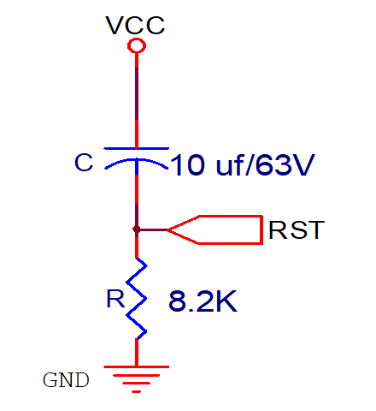
Power on reset circuit
In order to reset the controller, minimum two machine cycles time is required.
If 12MHZ crystal oscillator is connected, 1MC will take 1 micro second
i.e. minimum 2 microseconds time is required to reset the controller.

Slide 3
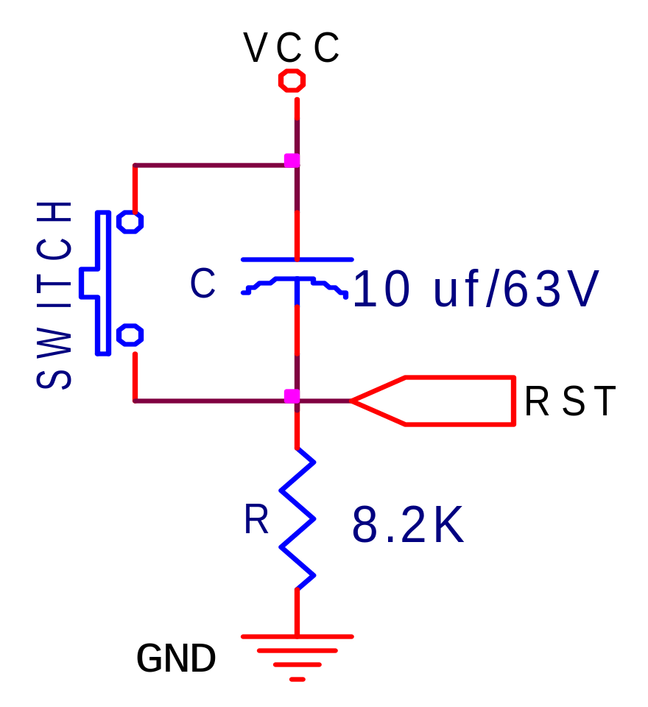
Power on reset circuit with switch for run time reset

Slide 4
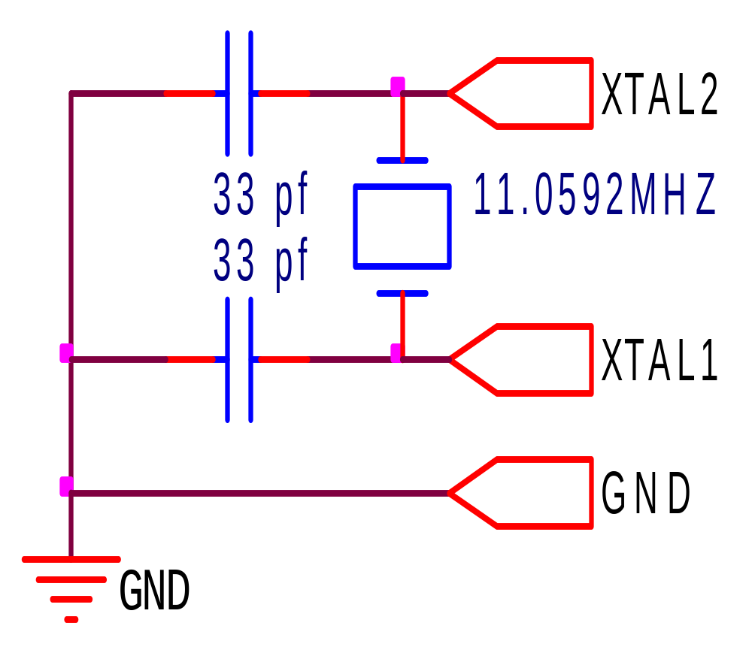
CRYSTAL CKT
C1, C2 = 30 pF ± 10 pF for Crystals (in between 20pF to 40pF)
= 40 pF ± 10 pF for Ceramic Resonators (in between 30pF to 50pF)

Slide 5
8051 Block Diagram
External Interrupts
Interrupt
Control
4k byte
ROM
128 byte
RAM
Timer 1
Counter
Inputs
Timer 0
CPU
OSC
Bus
Control
I/O Ports
Serial
Port
TXD
RXD
1MHz-16MHz
P0
P2
P1
P3
(Address / Data)
www.vectorindia.org

Slide 6
Minimum hardware requirements for 8051 CPU:
Power supply
Pullup for PORT0
Reset circuit
Crystal circuit
EA(bar)/VPP pin is connected to VCC (in order to access the on-chip ROM)
ISP connections (used for hex file loading to the flash memory)

